Slide 1
CREDIT SCORE PREDICTION
Group 6
Ayushi Srivastava, Harsh Mehta, Jiang Hua, Yumu Chen

Slide 2
Contents
Objective
EDA
Feature Engineering
Modelling
Model Comparisons

Slide 3
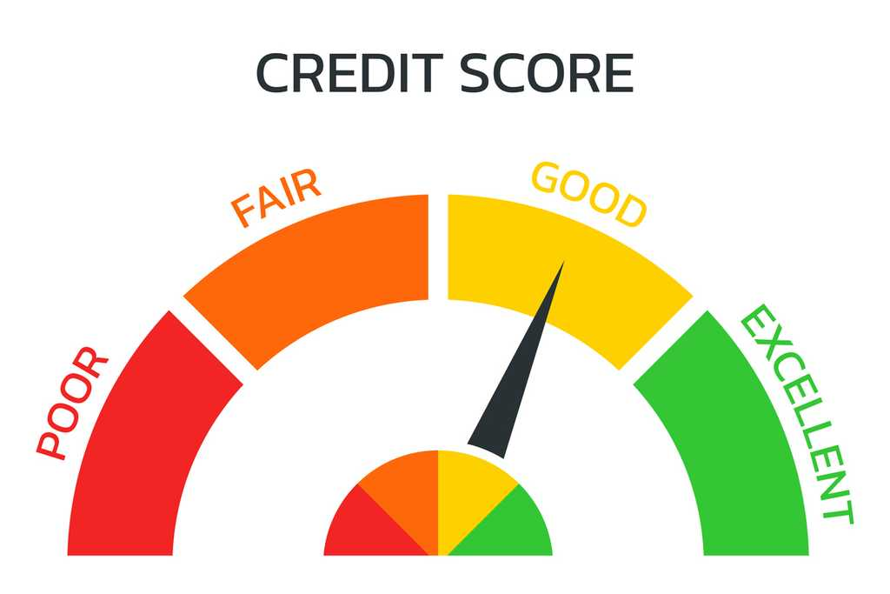

Objective
To demonstrate that by employing various machine learning techniques, we can effectively predict credit scores, enabling earlier identification of potential credit risks. This approach aims to assist in proactive financial management and potentially mitigate bad credit occurrences.

Slide 4
Data Cleaning & EDA
Dataset
individual's credit profile
8 month
150 thousand
28
Information
Time
Record
Variables
Removing some null/duplicate values.
Dealing with outliers.
Ensuring consistency in feature formats

Slide 5
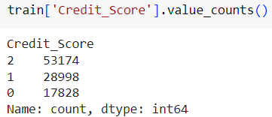
Label Imbalance
Make sense since most people got normal credit score
Add a layer of complexity to the training

Slide 6
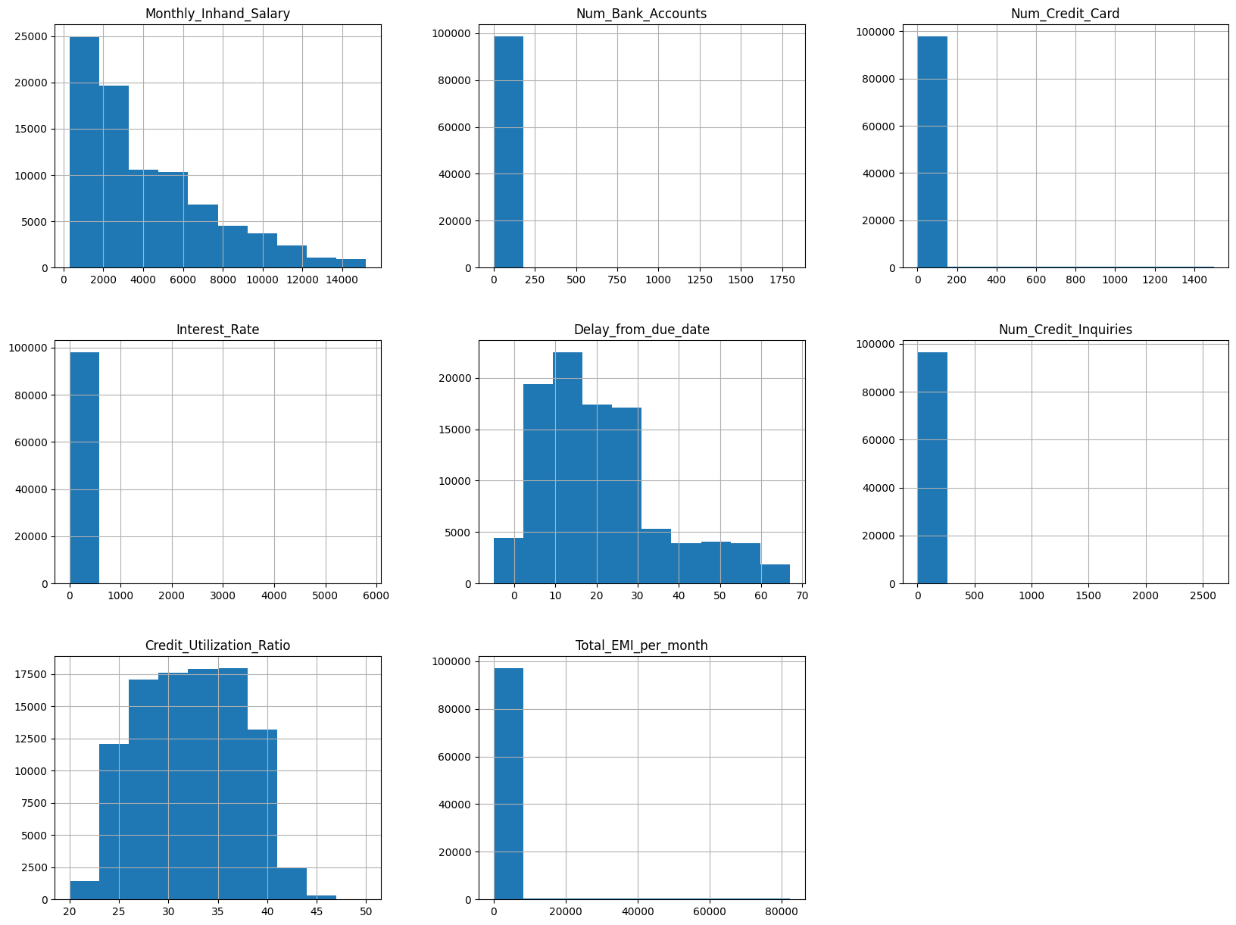
EDA
Most individuals have an income within the lower range
Majority have fewer bank accounts and credit cards
Most of the data focuses on interest rates and credit utilization in the lower ranges.
Delayed payments and credit inquiries with a notable peak in the lower bins.
EMI distribution is skewed towards lower monthly payments.

Slide 7
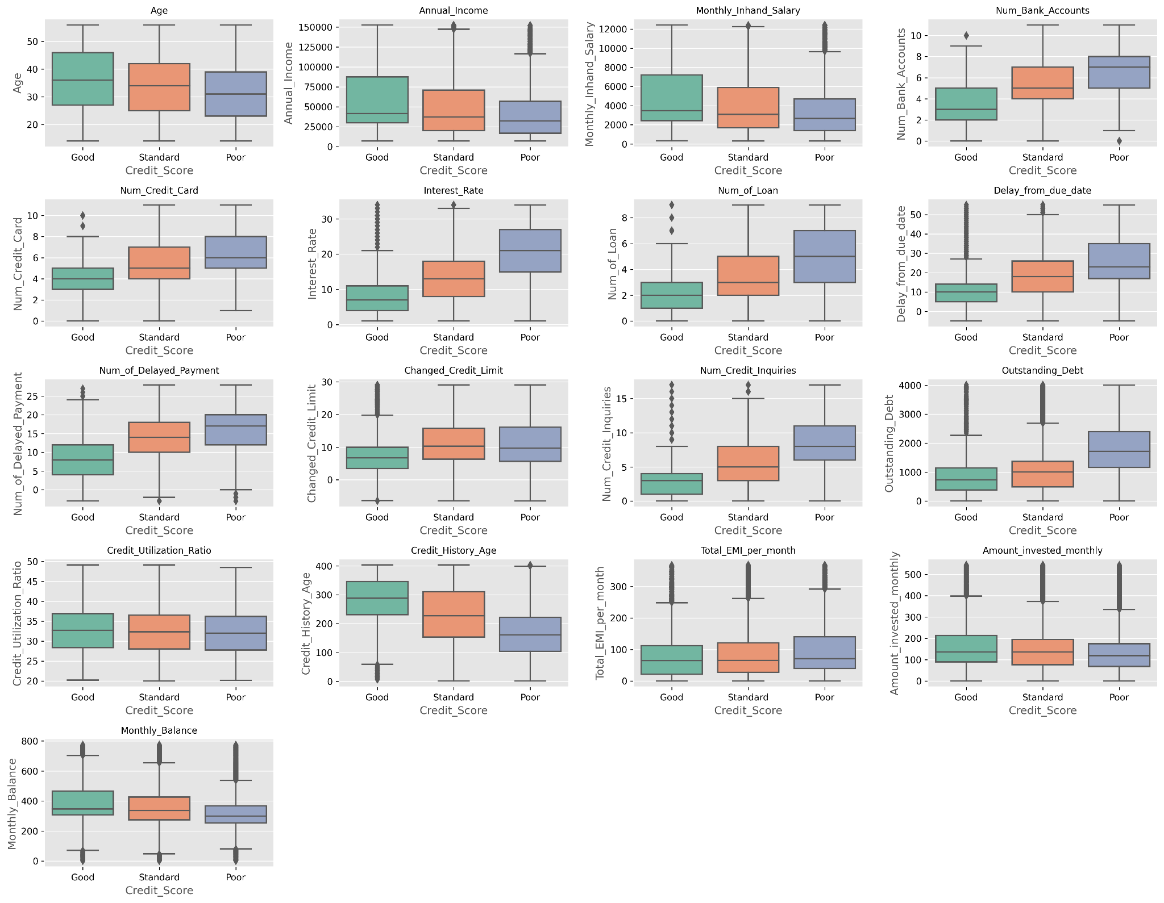
EDA
Higher incomes associated with better credit scores.
Good scores correlate with lower debt and credit utilization
More inquiries and limit changes seen with poor scores..
Higher investments and balances linked to good scores.

Slide 8
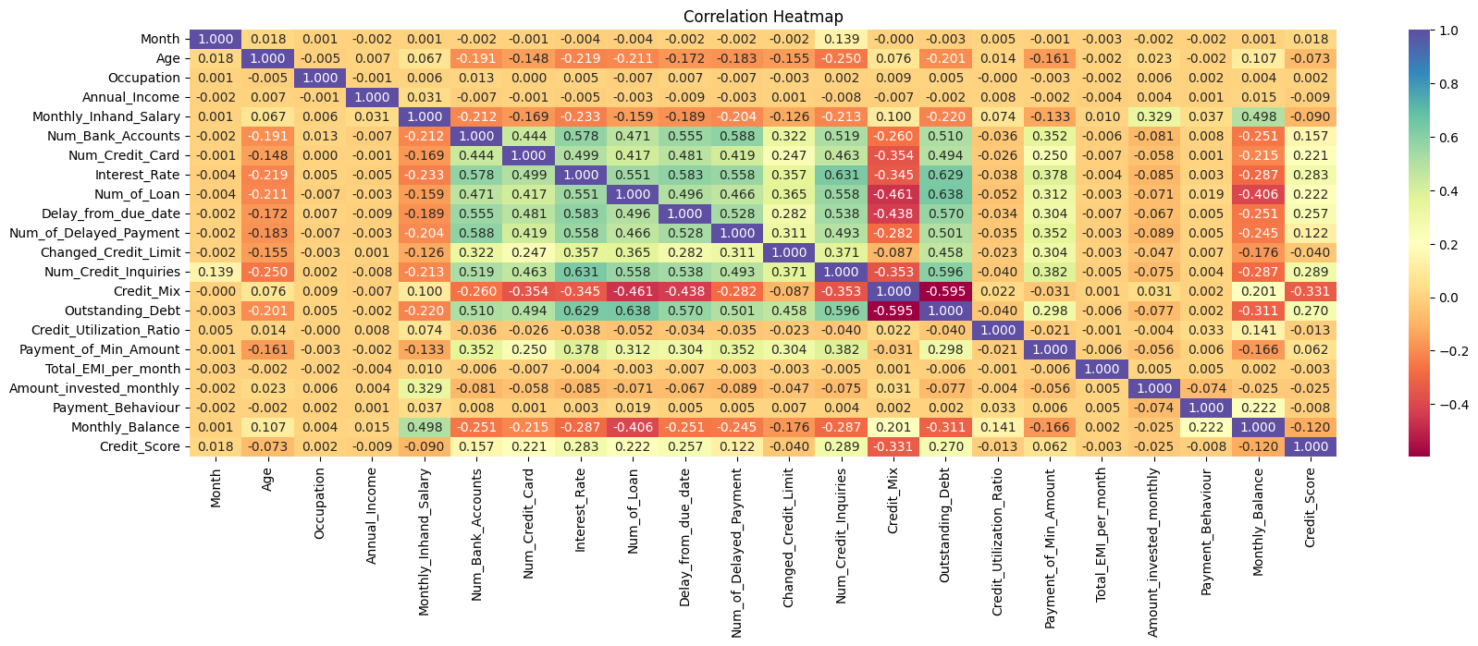
EDA
Interest Rate, Number of Previous Loans, Delay from due date, Number of Delayed Payments are positively correlated with our target variable.
Very few features are negatively correlated with our target variable, like Monthly Balance, and Monthly Inhand Salary.

Slide 9

Feature Engineering
Some features like Occupation, Payment Behaviour, Age are close to 0 and hence are not much related with our target in this dataset. Hence, we removed these variables to improve performance.
The categorical variable "Credit_Score" is encoded into numerical values using LabelEncoder. This transformation assigns a unique integer to each distinct category in the "Credit_Score" column.
Missing values are replaced with the mean of the non-missing values within each respective column. Subsequently, the fit_transform method is applied to the data which both fits the imputer to the data and transforms it by replacing any missing values with the computed mean values. This process ensures that the training data is complete and ready for analysis or modeling

Slide 10
Model Trainings
Logistic Regression (Baseline): It offers a straightforward and interpretable framework, allows us to easily comprehend the relationship between independent variables and the probability of the outcome. With efficient training procedures and low variance, logistic regression is less susceptible to overfitting
Naive Bayes: The naive assumption in the Naive Bayes theorem is that the features in a dataset are conditionally independent, given the class variable. This assumption simplifies calculating the probability of a particular class given a set of features, making the algorithm efficient and easy to implement.
Support Vector Machine: SVMs are effective in high-dimensional spaces, making them suitable for scenarios with complex data where the number of features exceeds the number of samples. They can handle both linear and non-linear data by using different kernel functions, allowing for flexibility in modeling various types of relationships between features and classes.

Slide 11
Model Trainings
K-Nearest Neighbors: KNN is a non-parametric method, meaning it does not make any assumptions about the underlying data distribution, allowing it to perform well on a wide range of data types and distributions. Moreover, KNN naturally handles multi-class classification problems and can capture complex decision boundaries, making it suitable for tasks with non-linear relationships between features and classes.
Decision Tree: They are highly interpretable, making them accessible even to non-experts, as they mimic human decision-making processes. Additionally, they can handle both numerical and categorical data without extensive preprocessing, simplifying the data preparation phase. Their ability to implicitly perform feature selection and capture non-linear relationships makes them suitable for a wide range of datasets.
All the training mainly used GridSearchCV for parameter tuning

Slide 12
Model Results
Model | Accuracy (On Test Data)
Logistic Regression (Baseline) | 0.8510
K-Nearest Neighbors | 0.7183
Decision Tree | 0.9993
Naive Bayes | 0.9914
Support Vector Machine | 0.9131

Slide 13
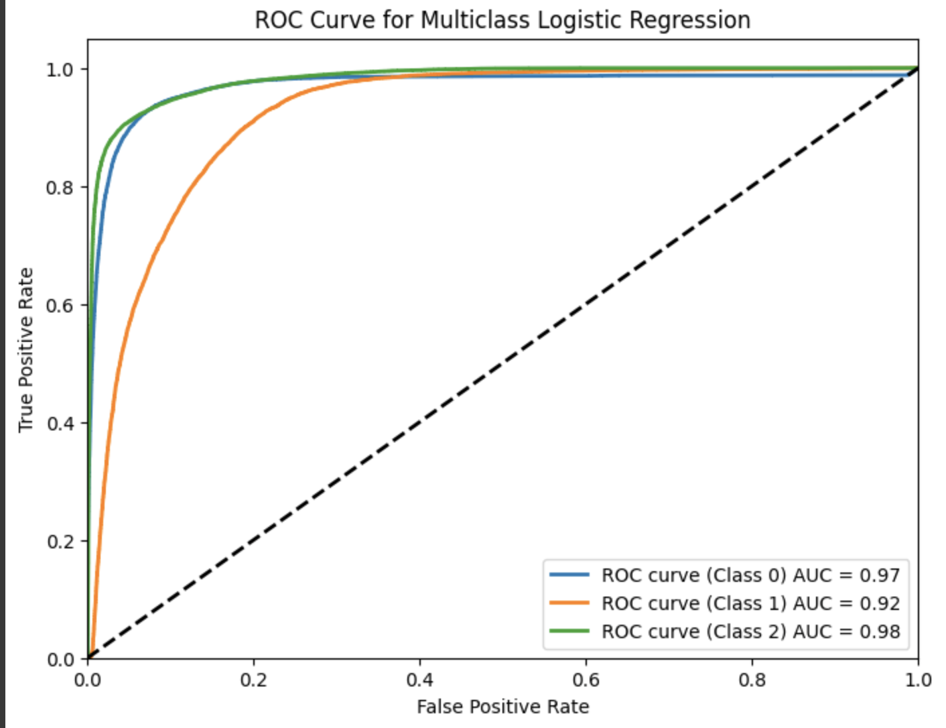
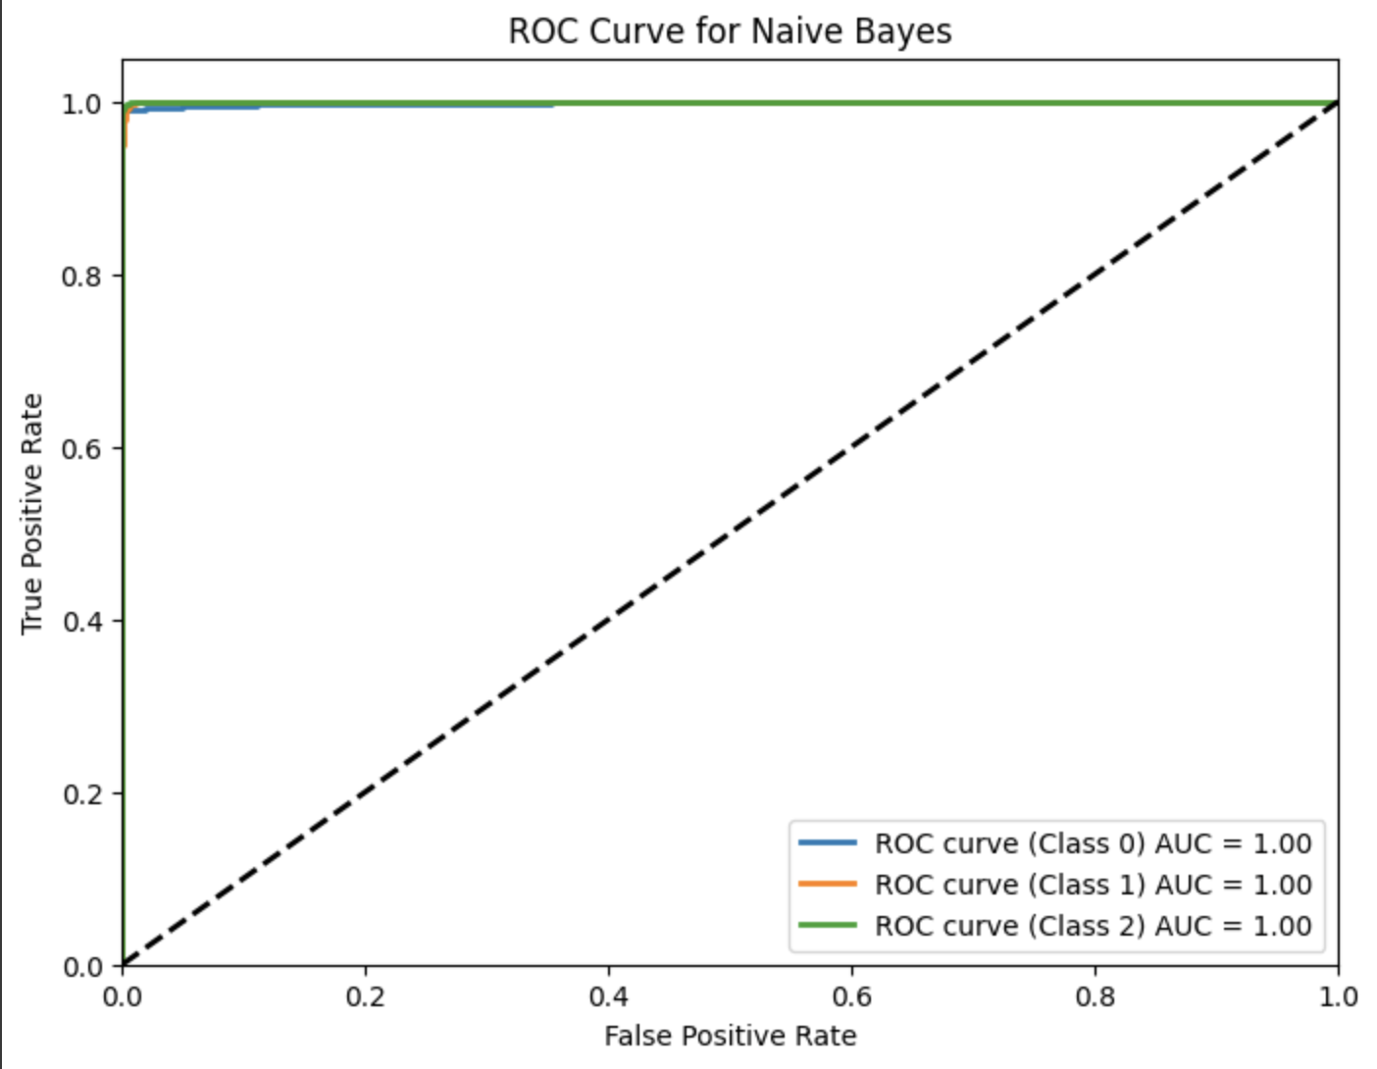
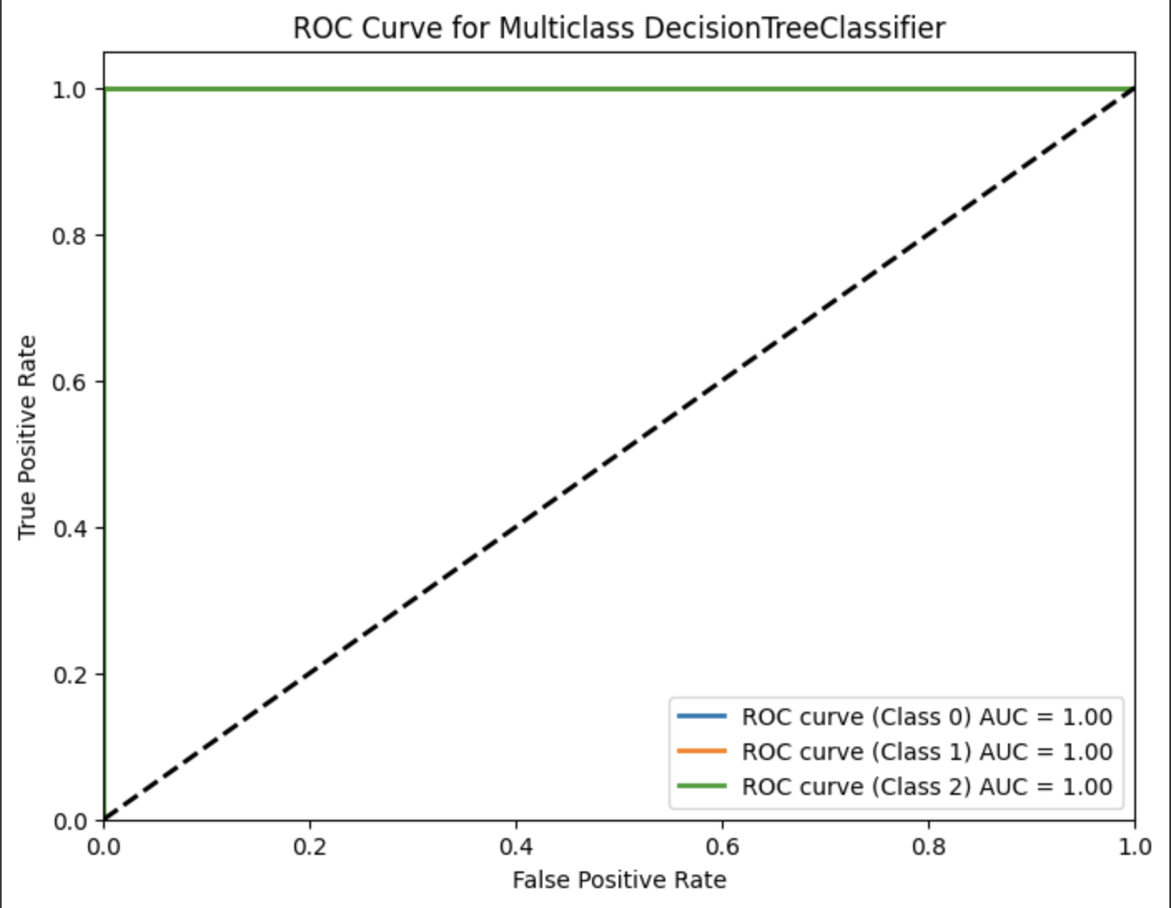
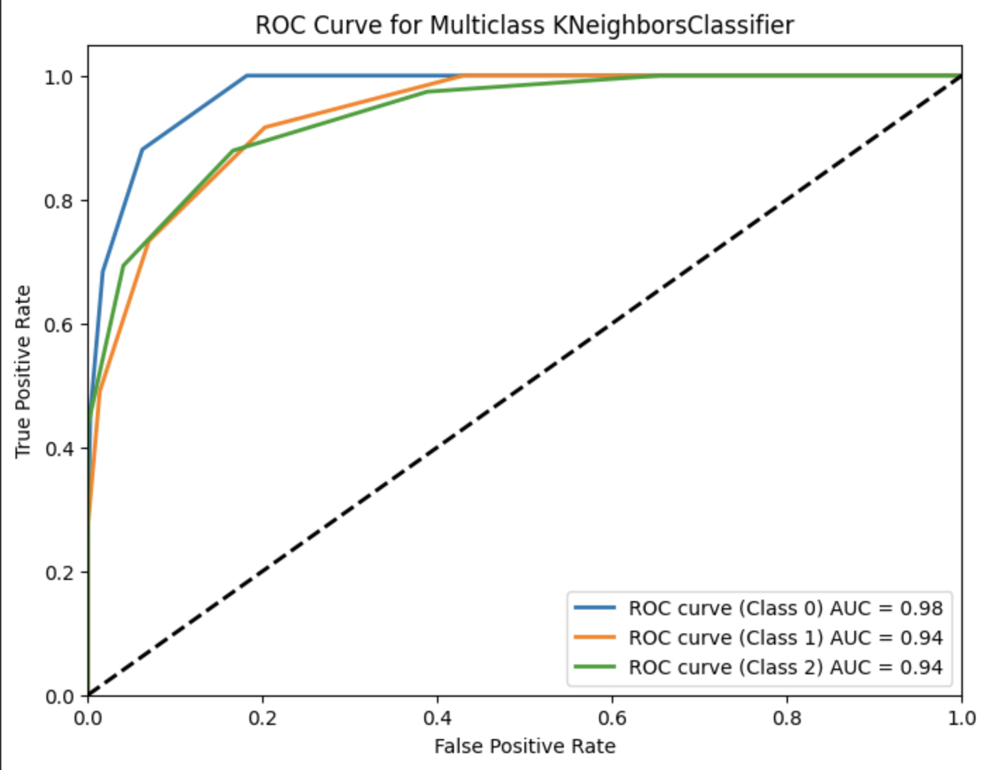
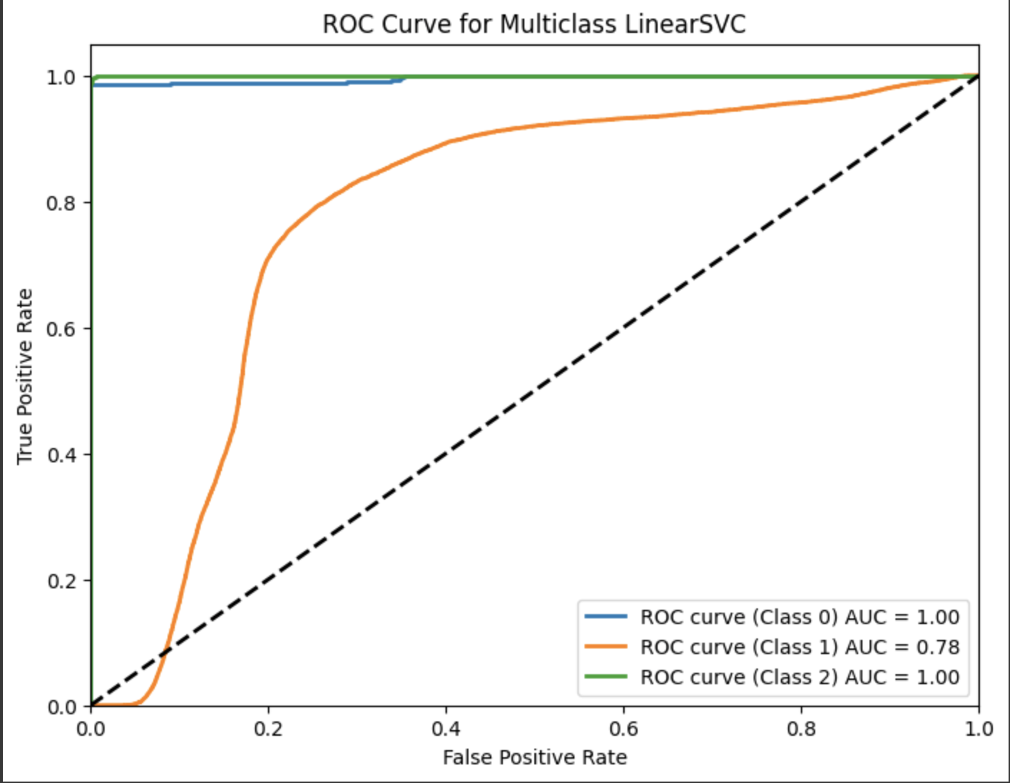
Comparison: ROC curves for the models
Logistic Regression
Naive Bayes
Decision Tree
KNN
SVM

Slide 14
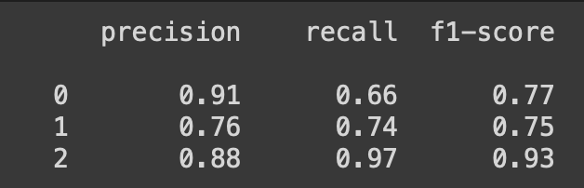
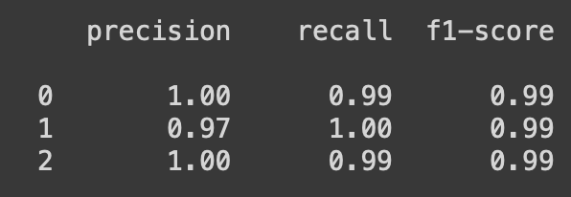
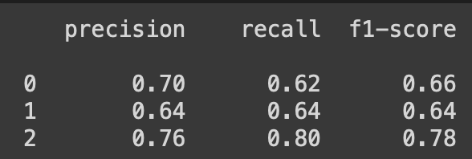
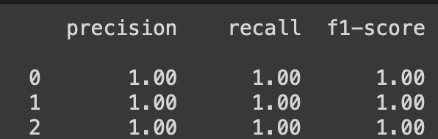
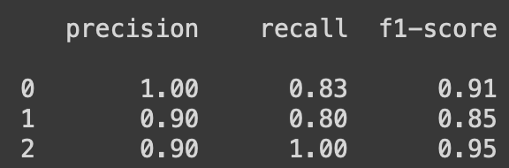
Comparison: Classification Report
Logistic
Naive Bayes
kNN
Decision Tree
SVM

Slide 15
Conclusion
While the ROC curve and AUC are valuable metrics for evaluating binary classification models, they may not adequately capture the performance when dealing with imbalanced datasets. In such cases, precision and recall become more important metrics to consider.
Logistic regression seemed to have high overall accuracy. While an AUC of 0.97 for logistic regression does suggest that the model has excellent overall performance in terms of its ability to discriminate between positive and negative instances, an F1-score of 0.77 for class 0 indicates that while the model is highly discriminative overall, there may be some room for improvement in terms of its precision and recall for this specific class. The same goes for other models with high AUC values.
The Naive Bayes model seems to be overfitting the data and gives an unreasonably high accuracy of 99%. Naive Bayes models assume independence between features, which may not hold true in real-world datasets.
Since the dataset is imbalanced, with one class dominating the others, it can lead to overfitting, especially in decision trees. The model may become biased towards the majority class, leading to poor generalization performance on minority classes.

Slide 16
Conclusion
To be improved:
Use KNN in fill NaN instead of empirical mean
Ditch target encoding to fix overfitting issue
Could use more time in fiddling with the tuning process

Slide 17
Thank you！
Do you have any questions?
Ask us! We hope you learned something new.

